Slide 1
SHOPPY-VUE
CAPSTONE PROJECT
Presented By : Meghana S
College Name & Department : East West Institute Of Technology,
Bengaluru.560091
CSE(IoT, CyS & BCT)

Slide 2
OUTLINE
Problem Statement
System Development Approach
Algorithm & Deployment
Result
Conclusion
Future Scope
References

Slide 3
Problem Statement
Data Management – Difficulty in handling and integrating large-scale product and customer data.
Personalization – Lack of accurate recommendations reduces customer satisfaction..
Search & Navigation – Inefficient search results and poor navigation affect user experience.
Scalability – Deployment bottlenecks cause downtime during high traffic loads..

Slide 4
System Approach
Front-end Development
HTML for structure.
CSS for design & styling.
JavaScript for provide a responsive and interactive shopping experience.
Data Source
Database: MySQL/PostgreSQL or NoSQL (MongoDB).
Integration
Customers browse products through the JavaScript-based frontend.
Requests are sent to the server APIs for product and user data.
The system fetches details from databases (products, users, orders).
Payments and delivery are handled via third-party APIs.

Slide 5
Algorithm & Deployment
Algorithm:
User → Frontend (JS/React) → Server (API Layer) → Database / Payment APIs → Cart & Checkout.
Example:
Input: User searches for “Sneakers”.
API Response: {product: "Sneakers", price: ₹1999, stock: Available}.
Output: Display product with image, price, stock status, and Add to Cart option.
Deployment:
Frontend: Runs in browser (JavaScript).
Hosting: Deployed on cloud platforms like AWS, Vercel, or Netlify with CI/CD.

Slide 6
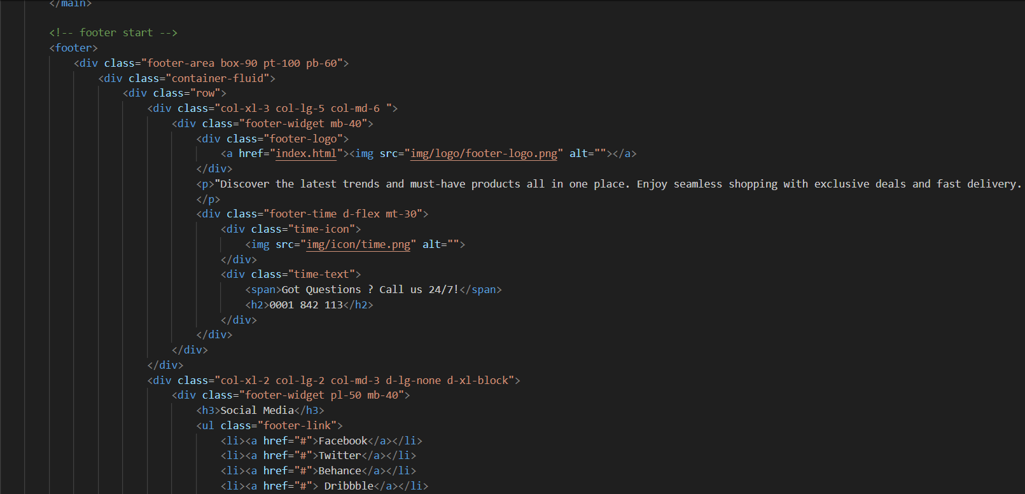
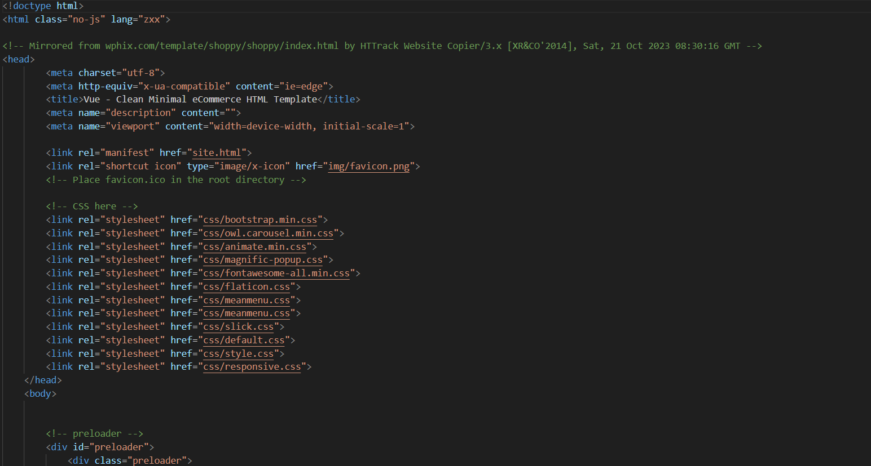
code

Slide 7
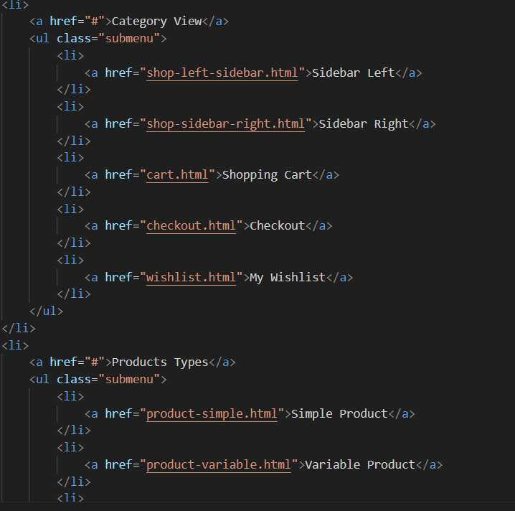
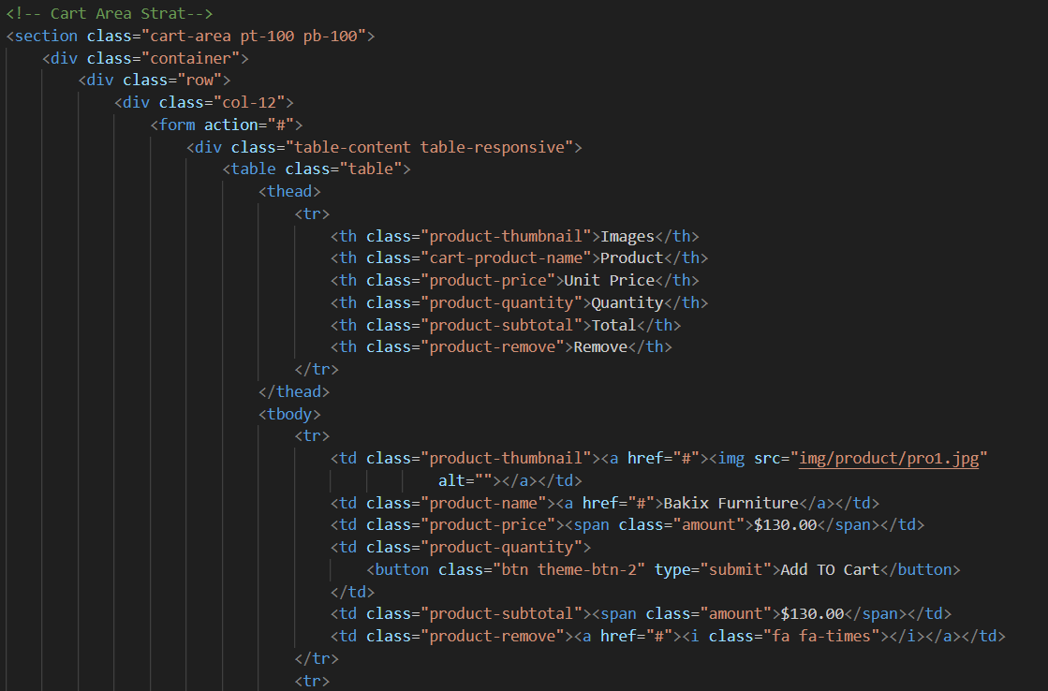
code

Slide 8
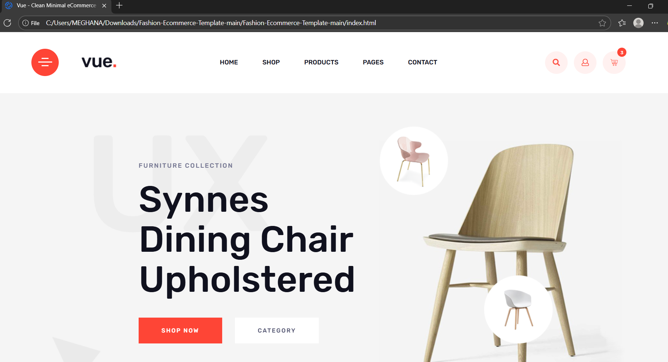
Result

Slide 9
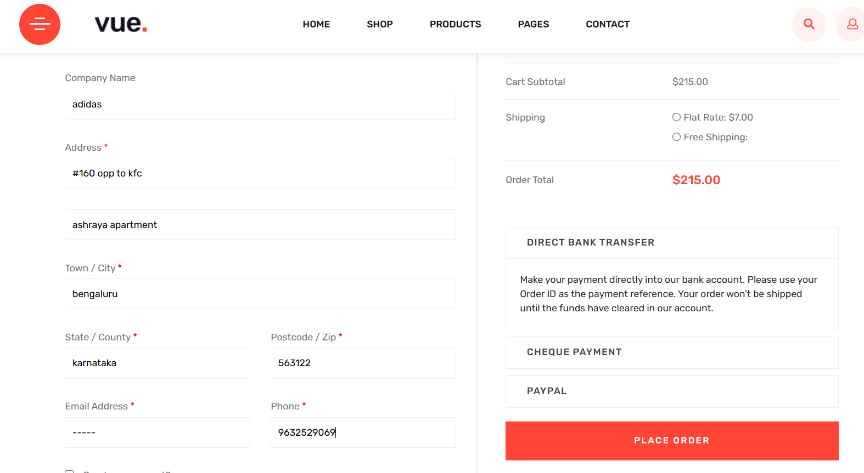
Result

Slide 10
GitHub and deployment link
GitHub Link
https://github.com/meghana-1003/Shoppy-vue.git
Deployment Link
https://meghana-1003.github.io/Shoppy-vue/

Slide 11
Conclusion
The system provides a seamless e-commerce experience with efficient data integration.
Algorithms enhance user satisfaction through personalization and secure transactions.
Cloud-native deployment ensures scalability, reliability, and continuous improvement.

Slide 12
Future scope(Optional)
Integration of AI chatbots for customer support..
Blockchain-based secure payment and order tracking.
Augmented Reality (AR) for product visualization.
Advanced predictive analytics for inventory management.
Voice commerce (integration with Alexa/Google Assistant).

Slide 13
References
Tanenbaum, A. S., & van Steen, M. (2016). Distributed Systems: Principles and Paradigms.
W3Schools – HTML, CSS, JavaScript Tutorials
AWS Documentation – Cloud Deployment & Scaling Strategies.
Fowler, M. (2010). Patterns of Enterprise Application Architecture. Addison-Wesley.
IEEE Xplore & ACM Digital Library – Research papers on recommender systems and e-commerce platforms.

Slide 14
THANK YOU

